Slide 1
Analysis of Player Transfer
Hao wang, anqi mao

Slide 2
Problem:
How’s player transfer of a team at specific season?
Successful or not?
--- Better rank? How much club spent to get that rank?
How good or bad?
--- Improved offense or defense?

Slide 3
solution:
How’s player transfer of a team at specific season?
Successful or not?
→ Cost-Rank
How good or bad?

Slide 4
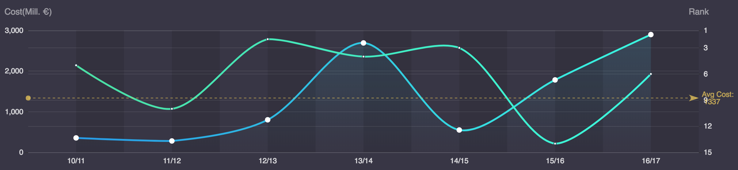
result:
How’s player transfer of a team at specific season?
Successful or not?
→ Cost-Rank → Line chart
How good or bad?
Blue: cost Green: rank

Slide 5
solution:
How’s player transfer of a team at specific season?
Successful or not?
→ Cost-Rank
How good or bad?
→ Records: rank, goals, shoot …

Slide 6
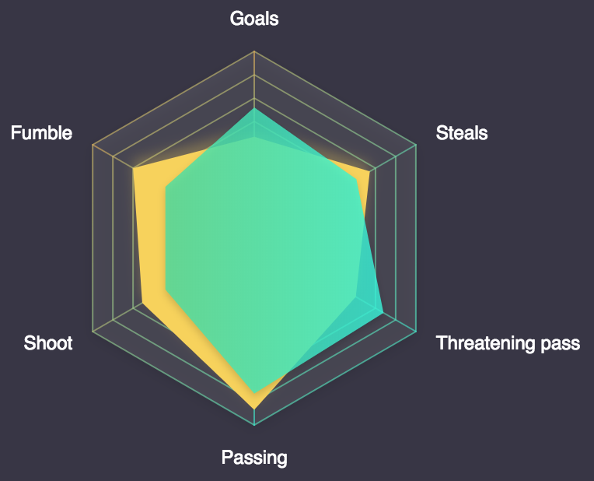
result:
How’s player transfer of a team at specific season?
Successful or not?
→ Cost-Rank
How good or bad?
→ Records: rank, goals, shoot … → Radar chart
Yellow: previous Green: current

Slide 7
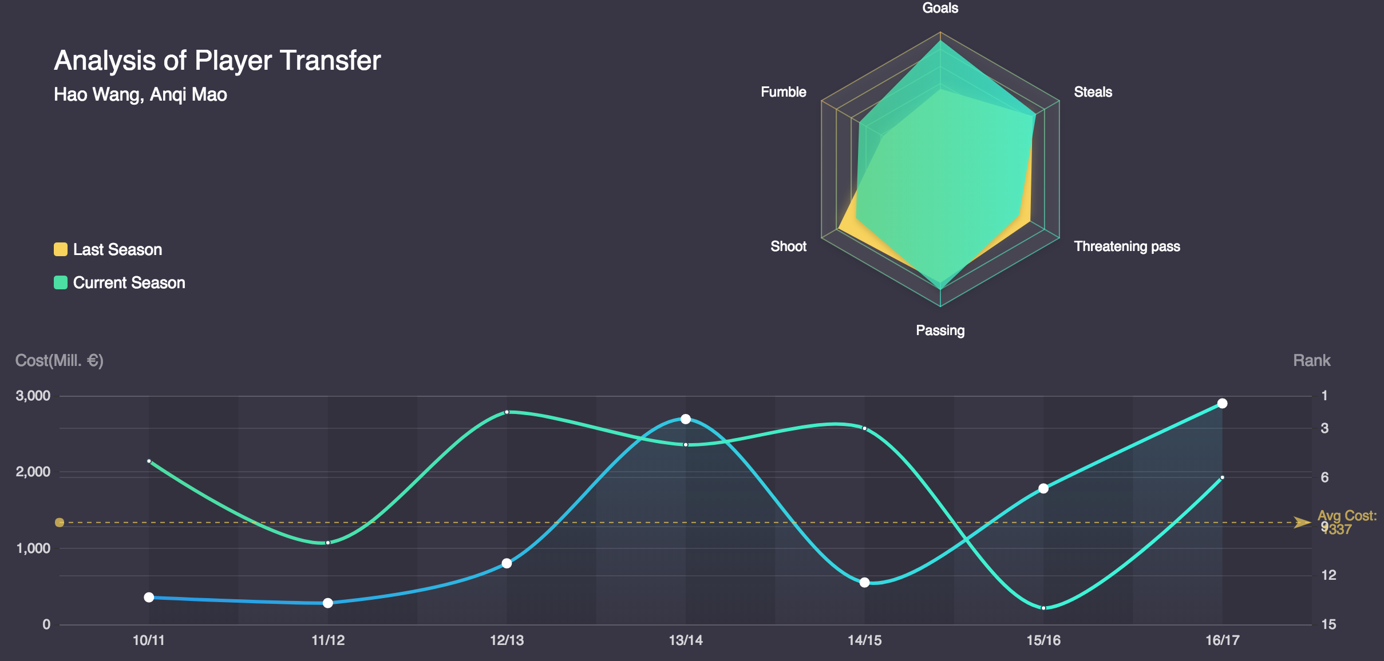
assess:
How’s player transfer of a team at specific season?
Successful or not?
Most successful: 12/13
Most unsuccessful: 15/16
How good or bad?

Slide 8
assess:
How’s player transfer of a team at specific season?
Successful or not?
Most successful: 12/13
Most unsuccessful: 15/16
How good or bad?
Although less shoot and threatening pass, more goals : offense more efficient

Slide 9
Thanks

